Slide 1
December Credit Card Marketing Planning
V1 12/20/18

Slide 2
Credit Card Marketing Considerations
Business Requirements
Primary Marketing Channels
2 Cards
  B&H Edge – 2 “legal flavors”
  B&H Special Financing
2 Applications, Accounts and Customer Support
  B&H Assets & Cust Service
  Synchrony Accounts & CC
Check Out UX and Payments
  B&H Assets & Cust Service
  Synchrony Accounts & Cust Ctr
B&H Channels
  Website (desk and mobile)
  Emails / Push
  Paid Search and SEO
  Affiliates
  Social / YouTube ad placement
  Video ads: dedicated or coop
  PR, OOH, Direct Mailers, etc.
  Future: pre-screened/approved customer checkout pop-ups
Synchrony Digital Channels
  Site: Homepage Hero, Category Listing, Offers (desk and mobile), etc.
  Emails, incl. Trigger Campaigns
  Paid Search and SEO
  YouTube placement
  Pre-approval offers / letters

Slide 3
B&H Edge Card Marketing Language
Yes (~25 states)
No Limiting Tax Language
No (~6 states)
w/ Flat rates
No (~15 states)
w/ Varying rates
Use the Card,
Save The Tax*
You Pay the Tax, We Pay You Back
Use the Card,
Get #% Back*
Save with the B&H Edge
Use the Card,
Get #-#% Back*
Save with the B&H Edge
OR
OR
Use the Card,
Save #%*
Get the B&H Edge
Use the Card,
Save #-#%*
Get the B&H Edge
OR
Use the Card,
Get up to #% Back*
Save with the B&H Edge
OR
Use the Card,
Save up to #%*
Get the B&H Edge
*Required disclosures, including…
Offer does not apply to gift cards…. all other exclusions. Offer valid for purchases made in our NYC SuperStore, by phone or online for orders shipped to A, B, C, D, E F …. States. ….Offer not valid for orders shipped to A, B, C, D, E F …. States. Enter your zipcode [here] to see alternative offers for ineligible locations …or something to that effect
*Required disclosures, including…
Offer does not apply to gift cards…. all other exclusions. Offer valid for purchases made in our NYC SuperStore, by phone or online for orders shipped to A, B, C, D, E F …. States. ….Offer not valid for orders shipped to A, B, C, D, E F …. States. Enter your zipcode [here] to see alternative offers for ineligible locations …or something to that effect
*Required disclosures, including…
Offer does not apply to gift cards…. all other exclusions. Offer valid for purchases made in our NYC SuperStore, by phone or online for orders shipped to A, B, C, D, E F …. States. ….Offer not valid for orders shipped to A, B, C, D, E F …. States. Enter your zipcode [here] to see alternative offers for ineligible locations …or something to that effect
“No-tax” States
“Pre-collection” Wayfair States
Card available, but with No Incentive/Loyalty Offer
Do Not proactively market Edge Card

Slide 4
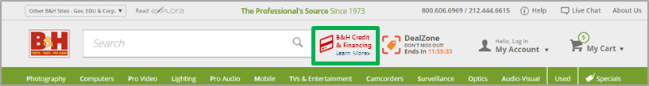
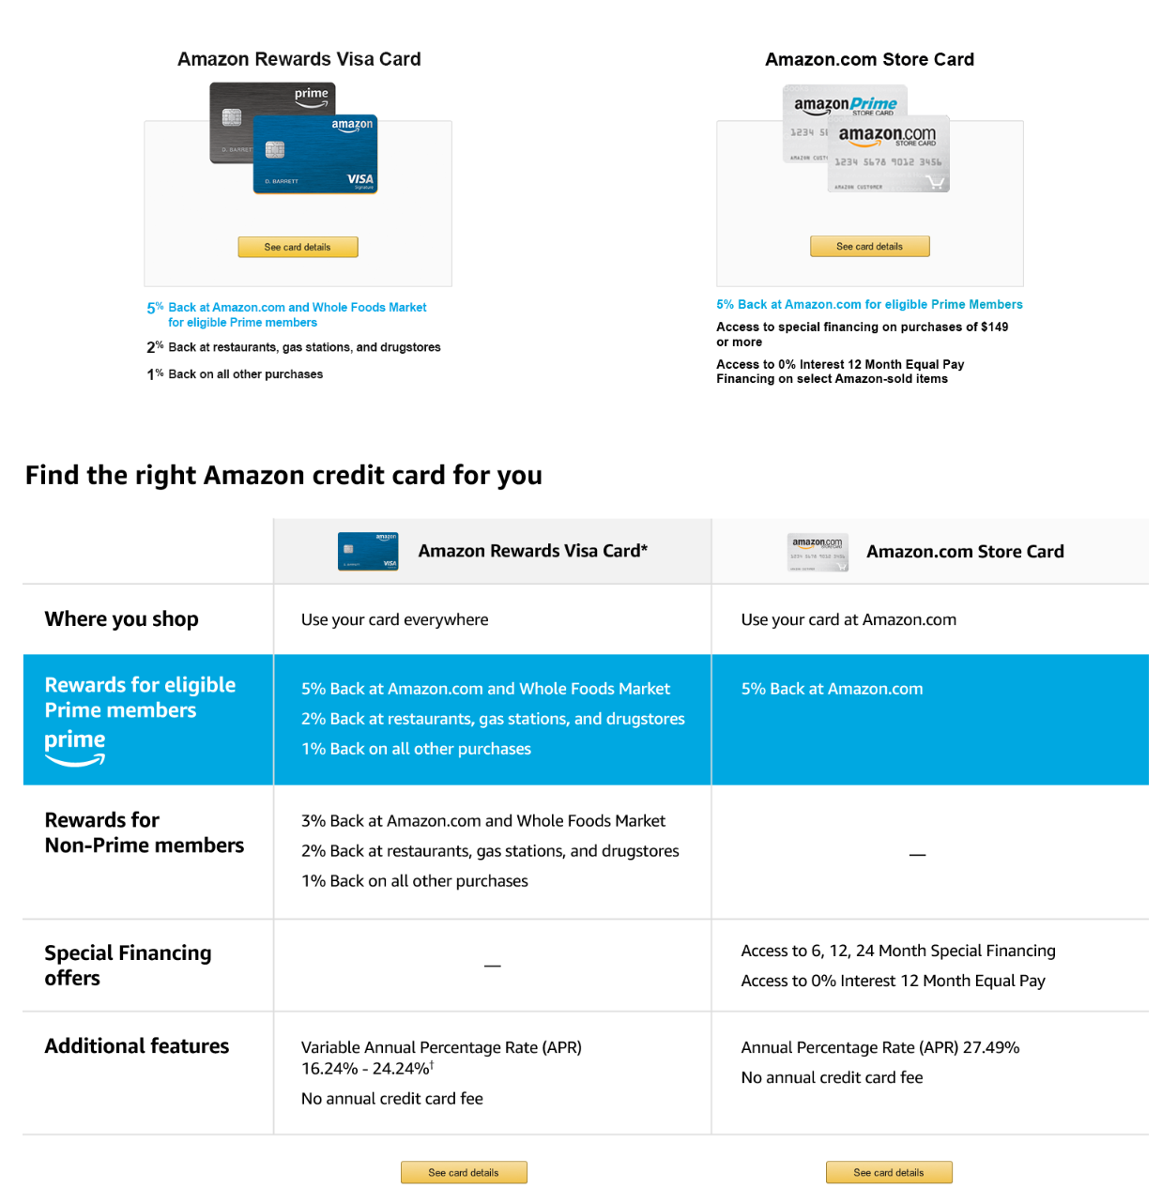
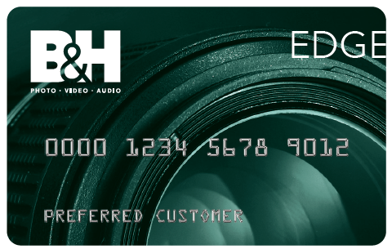
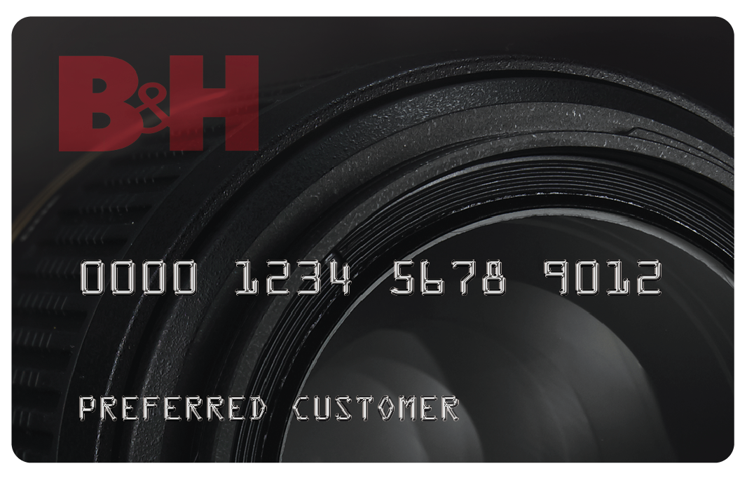

BANDH.com Example Universal Cards Offering Landing Page (ILLUSTRATIVE ONLY: layout similar to Amazon)
Two new cards from your favorite source for Photo, Video, Audio, Computing & more!
IP/Login Address/Entered ship-to address
B&H Edge Card
B&H Special Financing Card
In Green Jurisdictions:
TBD: What must or can we say about the % rate or amount received by Red States’ customers?
See Card Details
See Card Details
The Card that Pays you Back
Save the Sales Tax, where eligible*
No Interest when Paid in Full
When you pay for your B&H purchase with the
B&H Edge Card, B&H will apply a credit* directly on your purchase order, invoice and/or receipt.
Subject to credit approval.
*B&H Edge credit applied according to state and local rules.
When you pay for your B&H purchase with the
B&H Edge Credit Card, B&H will pay you back by applying a merchandise credit for the equivalent of the tax amount you paid with the card, directly on your purchase.
Subject to credit approval.
*B&H will collect and remit state and local sales tax on all requisite purchases based on the retail price paid by the customer.
Access to Special Financing on purchases
of $199 or more.
Subject to credit approval. Minimum monthly payments required.
Choose the Right B&H credit card for your needs… or, get both!
B&H Edge Card
B&H Special Financing Card
Where you shop
Use your card at www.bandh.com, the B&H NYC SuperStore, or by Phone or App
Cardholder Benefits
You Pay the Tax, We pay you back!
% Savings equivalent to the sales tax you pay with this card on every purchase.
Access to 6 and 12 Month Special Financing
No interest if paid in full during 6 Months on minimum $199, 12 Months on minimum $599.
Other Terms & Features
Annual Percentage Rate (APR) 29.99%
No annual credit card fee
See Edge Card Details
See Special Financing Card Details

Slide 5
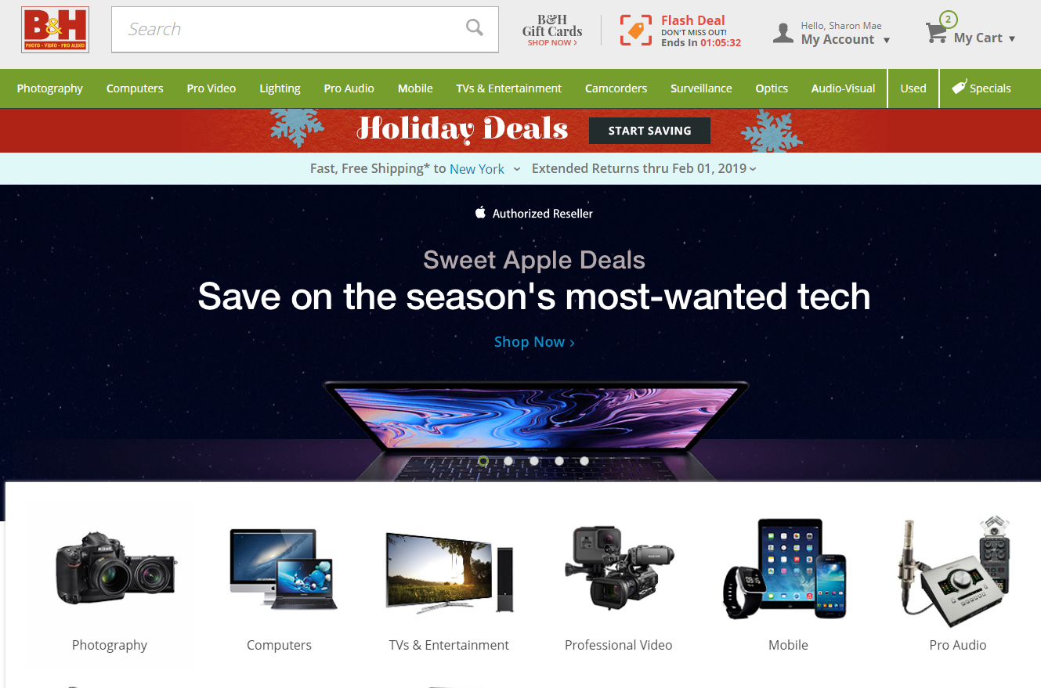
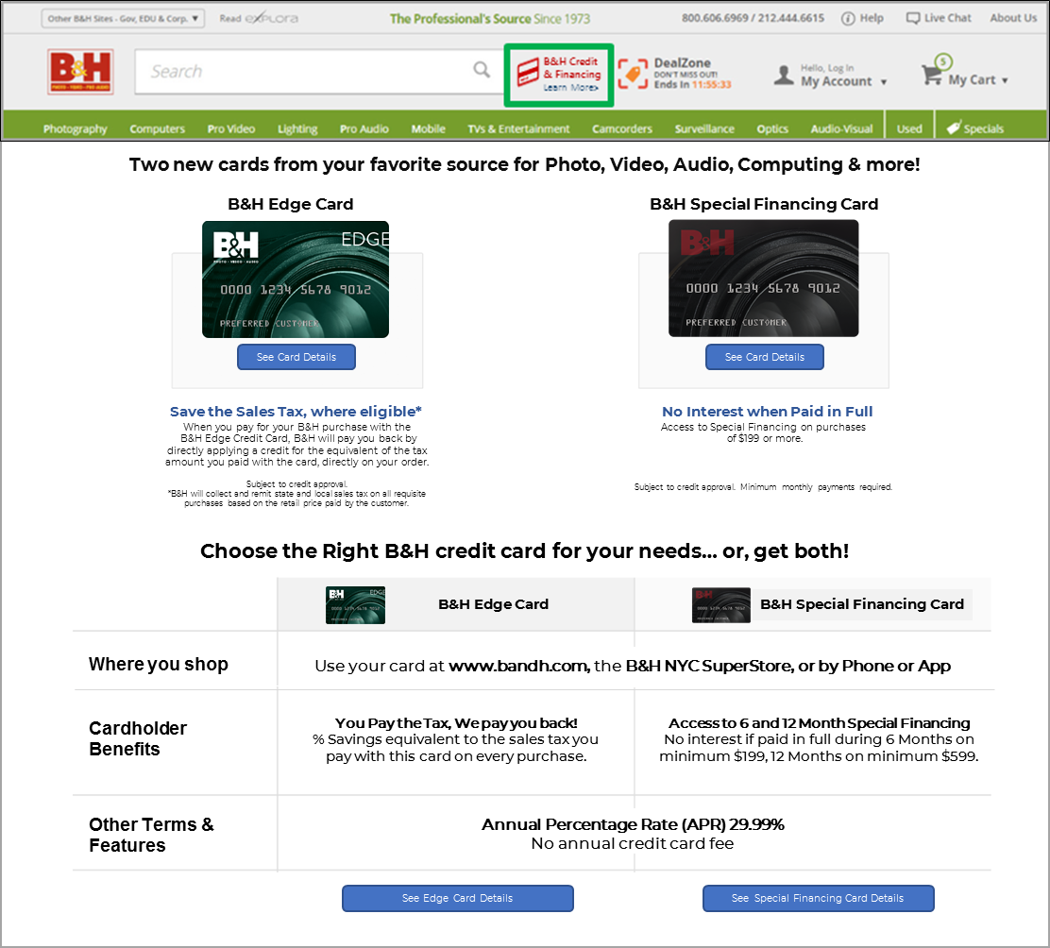
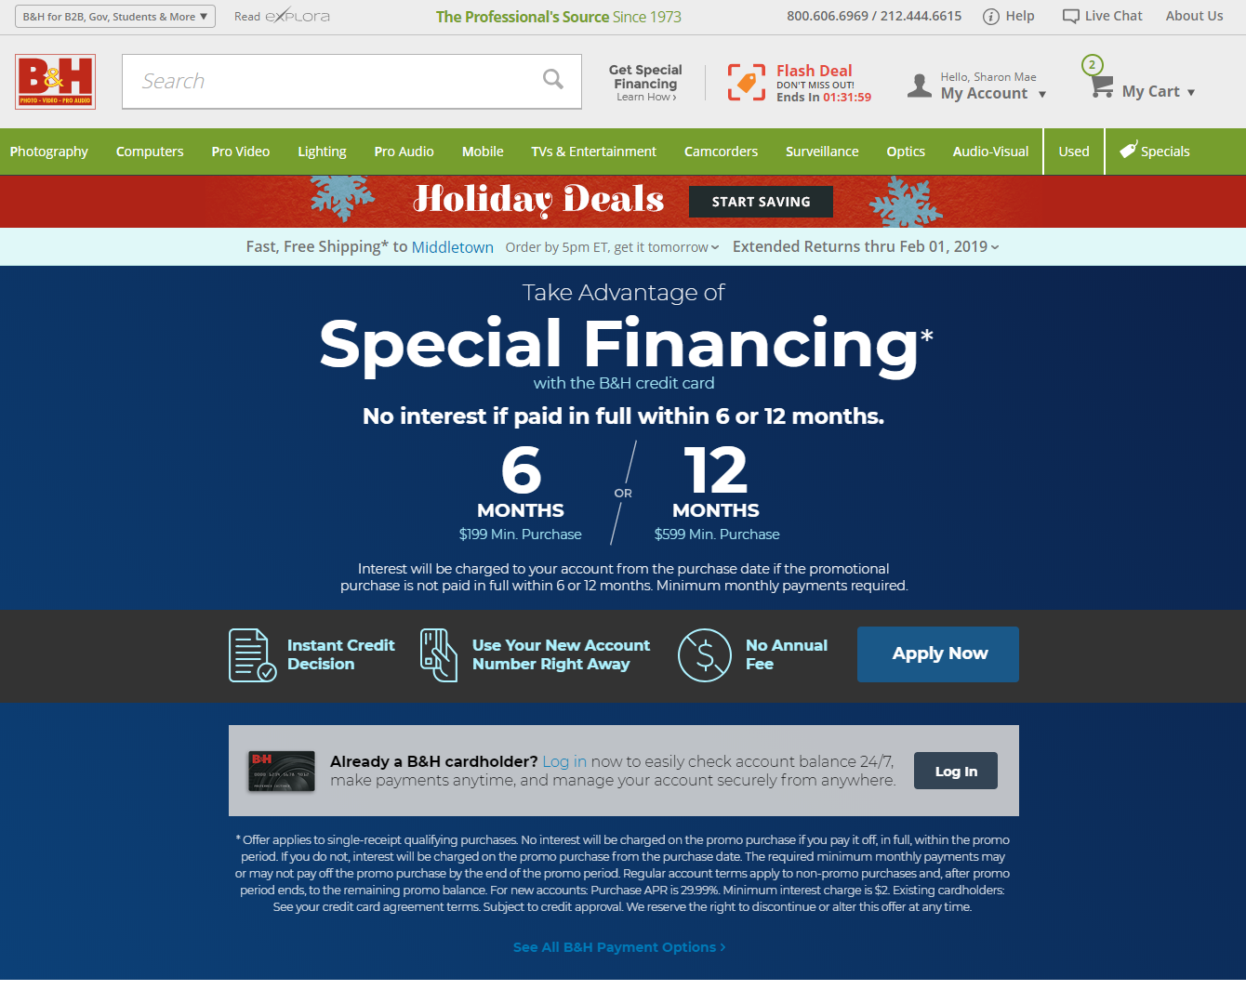
BANDH.com Marketing Placements (& rules)
IP/Login Address/Entered ship-to address
Banners:
- Combo B&H Credit Cards Offers
- Dedicated Edge Offer
- Dedicated Spec Fin Offer (existing approved)
Vary Edge Message by IP recognition and login-status for security
IP/Login Address/Entered ship-to address
IP/Login Address/Entered ship-to address
EDGE CARD GREEN
Landing Advertising
EDGE CARD RED
Landing Advertising
EDGE CARD RED
Landing Advertising
EDGE Green Disclosures
EDGE Red Disclosures
EDGE Red Disclosures

