Slide 1
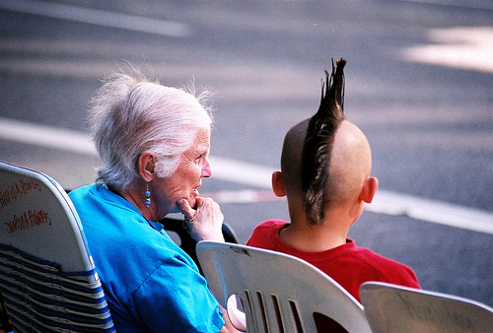
Attracting & Retaining Millennials

Slide 2
Generations in the Workplace
By now, most of us have learned that there are at least four generations in the workplace:
Traditionalists/Silents (Born between 1925 and 1946)
Baby Boomers (Born between 1946 and 1964)
Generation Xers (Born between 1965 and 1980)
Generation Ys or Millennials (Born after 1980)

Slide 3
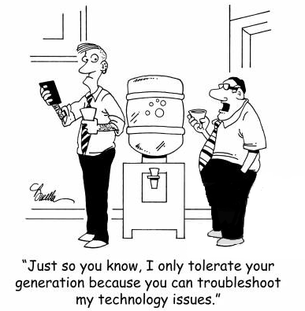

Slide 4
Generations in the Workplace
86 million millennials will be in the workplace by 2020—representing 40% of the total working population.
-Jamie Gutfreund, Chief Strategy Officer for the Intelligence Group

Slide 5
Studies of Millennials have found that:
64% of them say it’s a priority for them to make the world a better place.
72% would like to be their own boss.
If they have a boss, 79% of them would want that boss to serve more as a coach or mentor.
88% prefer a collaborative work-culture rather than a competitive one.
74% want flexible work schedules.
88% want “work-life integration,” which isn’t the same as work-life balance, since work and life now blend together inextricably.

Slide 6
The Millennial Profile: Values
Fun – Millennials expect to have fun at work, knowing they’ll spend a majority of their time there. It’s no longer about “becoming a partner” or “moving up the corporate ladder.”
Education – Many Millennials will enter the workforce with a college degree, they’re raised to believe that education is the path to success.
Work/Life Balance – Millennials place high value on personal relationships, community engagement and travel, and want time to pursue outside interests. It’s not “all about work.”

Slide 7
The Millennial Profile: Needs
Recognition and Appreciation – Millennials need instant gratification such as small rewards, titles, and non-monetary rewards.
Coaching – Millennials want to develop their skills & know how they’re progressing. They’ve been in school from ages 5 to 22 so they are used to progress reports.
Time Off and Flexibility – Many have non-work commitments that they prioritize (sometimes higher than work).

Slide 8
The Millennial Profile: Strengths
Tech Savvy – Having grown up with computers, the internet and social media puts them at an advantage.
Multi-tasking – Used to having multiple responsibilities or goals to achieve at a time.
Loyalty – Loyalty to the boss is the #1 reason they stay in a job, especially during the first few years. Millennials want a boss who is willing to coach and teach them, motivate them to do better and teach them new skills.
Problem Solving – Millennials grew up learning how to figure things out on their own, they can come up with creative ways to solve problems.

Slide 9
The Millennial Profile: Challenges
Job Security – They are more likely to change jobs than generations before them … 2-3 years then move on.
Work Ethic – Is not bad, just different. Millennials have NOT been raised to look around and see what they should do next. They do best with a list of tasks to complete and need to have control over their daily tasks by being able to choose what to do next.
Communication – They often resent being handed busywork with no explanation to its purpose. Take the time to explain how their work will lead to specific results.

Slide 10
The Millennial Profile: Engagement
Teamwork – Millennials understand the value of working with a team and enjoy camaraderie. They’re comfortable asking for advice and are used to getting responses quickly.
Social Responsibility – Their access to the world has sensitized them to how hard life can be for the less fortunate. They are involved in social causes, and often volunteer to try and help improve their community or the less fortunate.

Slide 11
The Millennial Profile: Motivation
Flexibility – Allow millennials to blend work with the rest of their lives. A flexible schedule and casual work environment make it seem less like work and more like fun.
Clarity – A clear career path and clearly laid out goals help them feel like they are in control of their careers and what the vision is, what they’re working towards.
Encouragement and regular feedback – They want to know how you think they’re doing.

Slide 12
Brainstorm
What are some methods for attracting and retaining millennials?

Slide 13
Things You Can Do …
Develop in-between steps and titles
Non-monetary rewards (leadership training, leading meetings, on-boarding new employees)
Flexible work schedule – flex hours, work from home, PTO, company laptops and wifi to work outside, Friday half-days, non-holiday days off (ex: option to take off the day after the Super Bowl or day after Thanksgiving)
Casual dress code
Workplace teambuilding – happy hours (can be alcohol free), scavenger hunts, dress up days, office décor competitions, bring your pet to work, on-site gym equipment, snacks, etc.

Slide 15
Attracting & Retaining Millennials

