Slide 1
Website / iPad Wireframes/Requirements 10K Videos /my Zine /Search /Favorites
Original: July 2012
Updated: October 2012

Slide 2
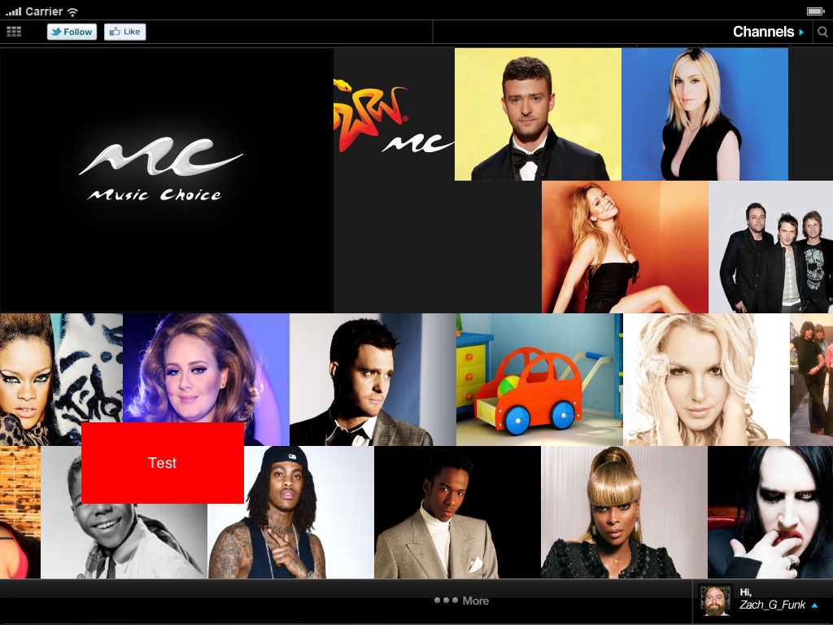
Landing Page
Activate the VOD bar highlighting VOD content.
Second bar on landing page is dedicated to VOD content. This screen is only for reference of the second bar position. The bottom and top bars should be ignored. No change to the current Landing Page other than the activation of the second bar.
Images are video stills
Each image represents a VOD asset
Assets to be programmed by Marketing; need to determine how they get programmed – back-up to link the user to My Music to Search VOD library?
1
2

Slide 3
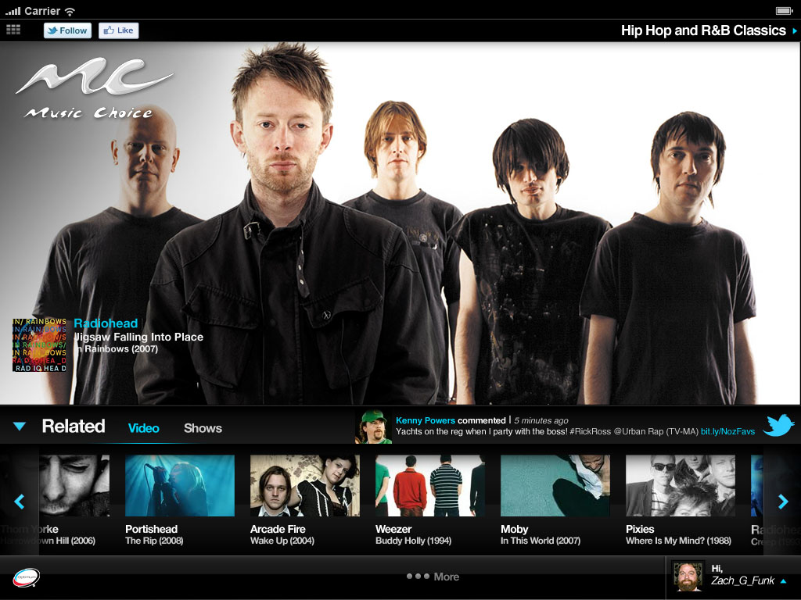
Audio Channel
This demonstrates an audio channel playing in the passive state
1. Current music playing.
1
2

Slide 4
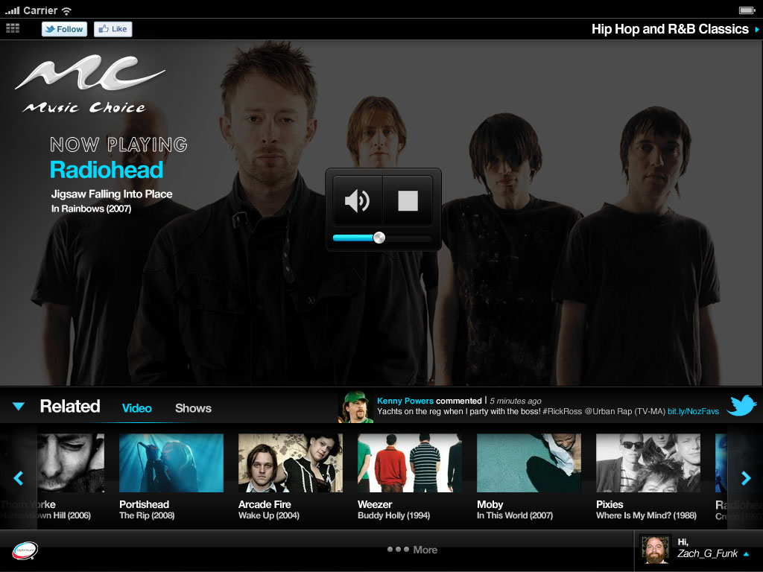
Audio Channel
This demonstrates an audio channel playing in the active state
1. Audio player controls
1
2

Slide 5
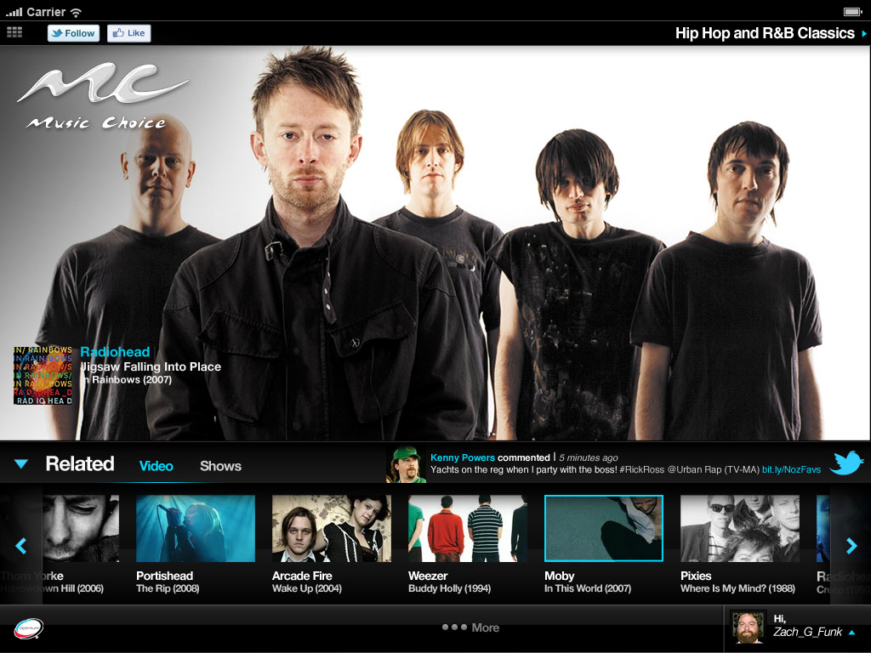
Audio Channel
1. This displays the active state when someone clicks to play a video.
1
2

Slide 6
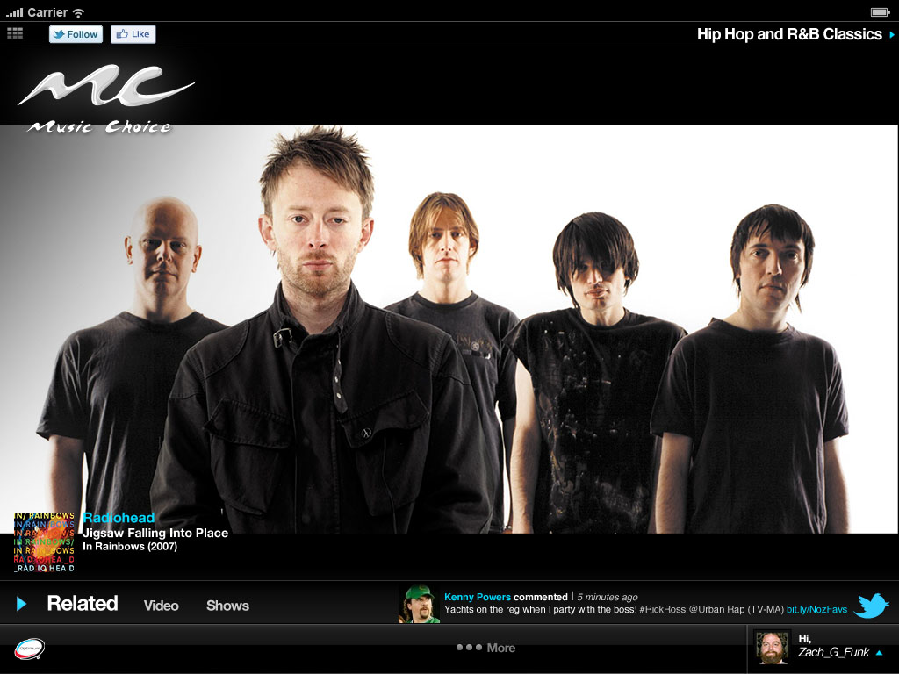
Audio Channel with Minimized Related Bar
This demonstrates the audio channel with the related bar minimized.
1. Related bar minimized. Clicking on the blue arrow will return it to the original upright position.
The artwork becomes center
2
1
2

Slide 7
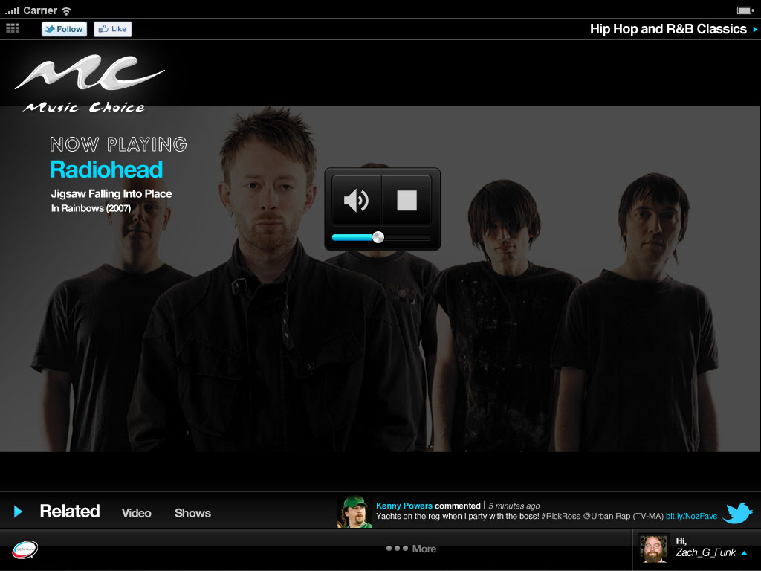
Audio Channel with Minimized Related Bar
This demonstrates the audio channel with the related bar minimized in the active state.
1. Audio player controls.
1
2

Slide 8
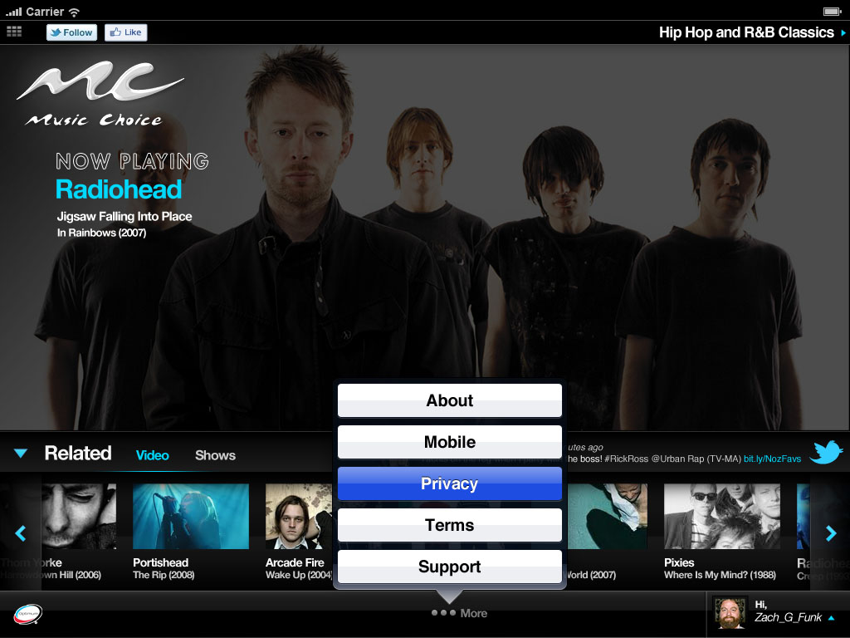
More Button
1. Clicking on the more button brings up the corporate links.
1
2

Slide 9
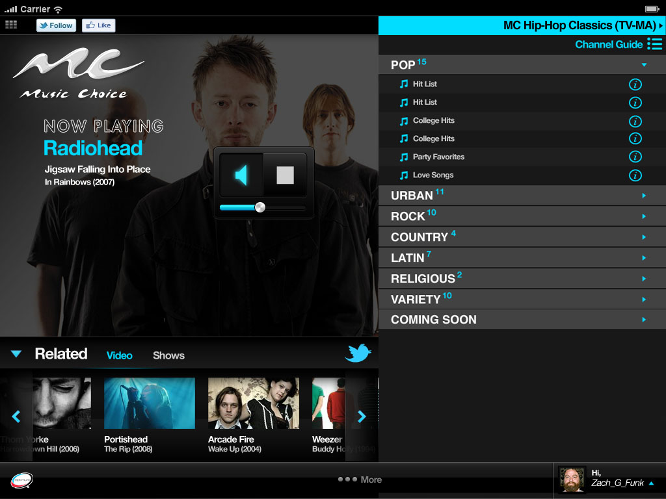
Audio Player Controls
This demonstrates the active mode controls.
1. The Stop button
Volume Control
Mute button, over
3
1
2
2

Slide 10
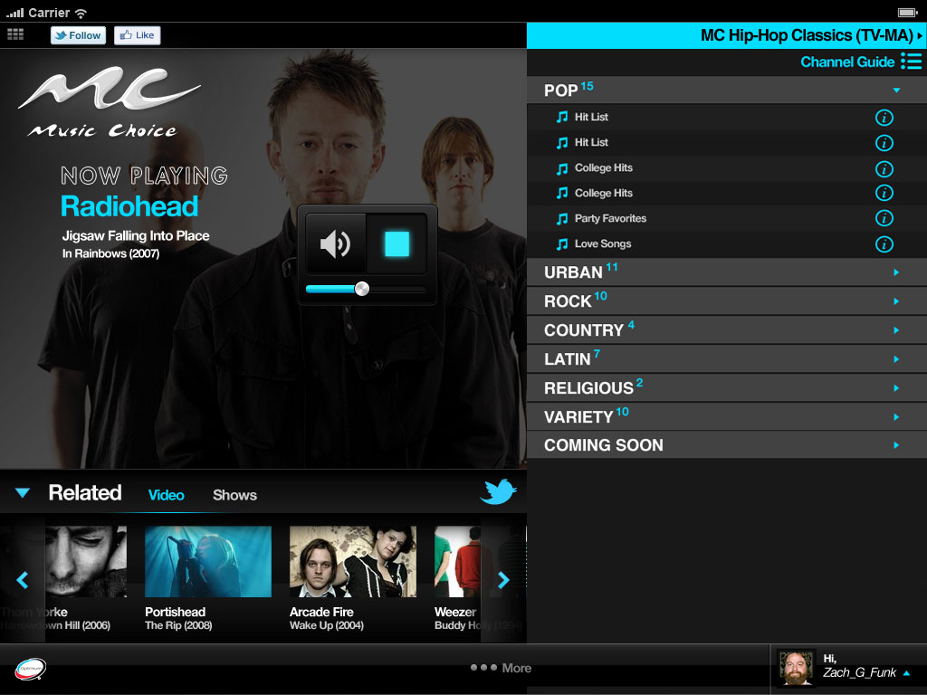
Audio Player Controls
This demonstrates the active mode controls.
1. The stop button in the over position.
Volume control.
Mute button
3
1
2
2

Slide 11
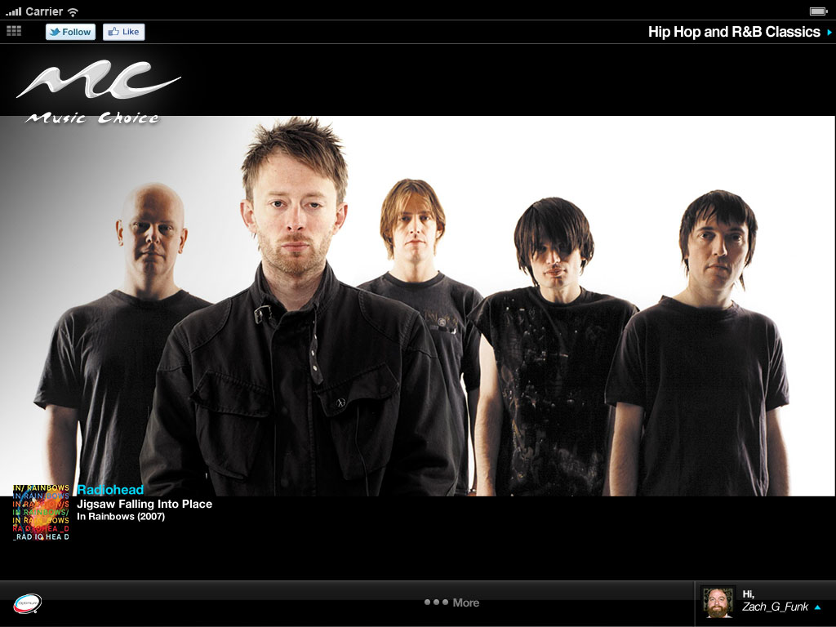
Full Screen Video
This demonstrates the video channel in passive mode
2

Slide 12
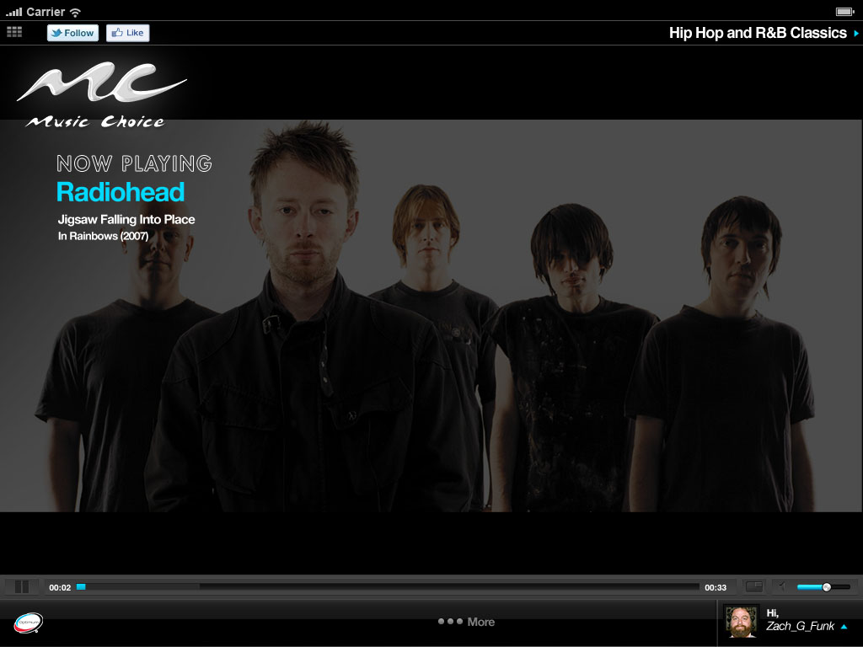
Full Screen Video
This demonstrates the video channel in full screen mode in active mode
1. Related bar minimized. Clicking on the blue arrow will return it to the original upright position.
The artwork becomes center
The button to return it back to the regular view and volume controls
2
1
3
2

Slide 13
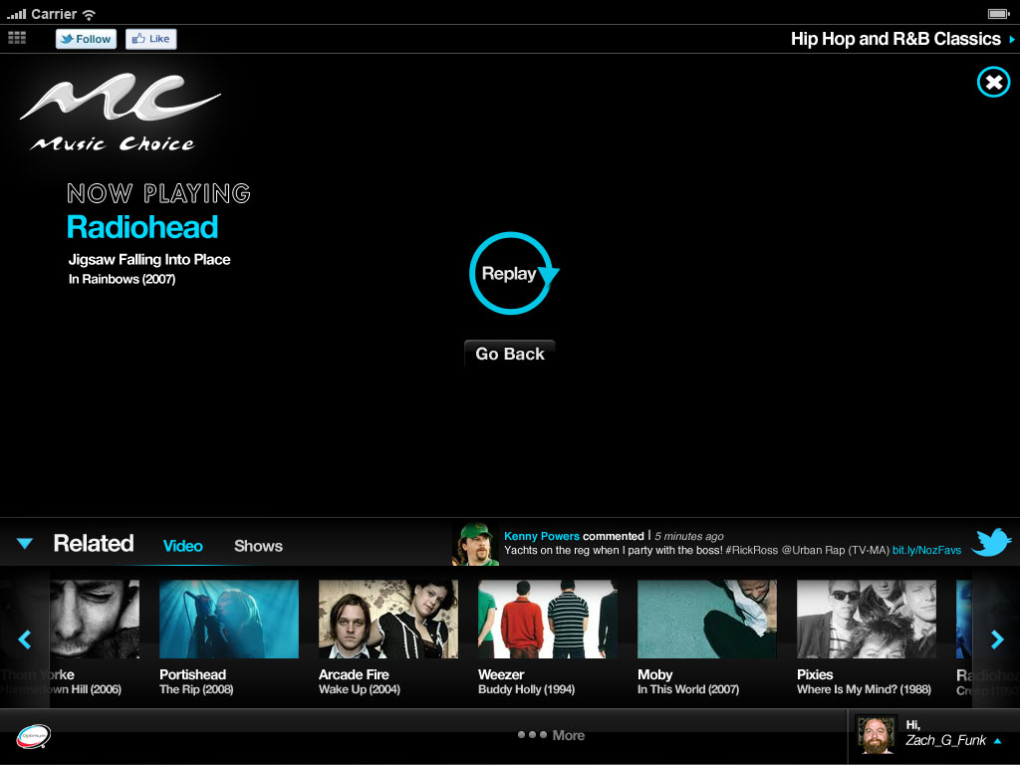
Playing a Single Play Video from Landing Page
This demonstrates the screen view at the end of a video played from the Landing page.
1. User is given 2 options at the end of the video play:
Replay
Go Back (will take them back to the Landing page in this scenario)
2
1
The user can also choose ‘X’ which will take them back to the Landing Page
The user can also choose a video from the Related Bar to play next
26

Slide 14
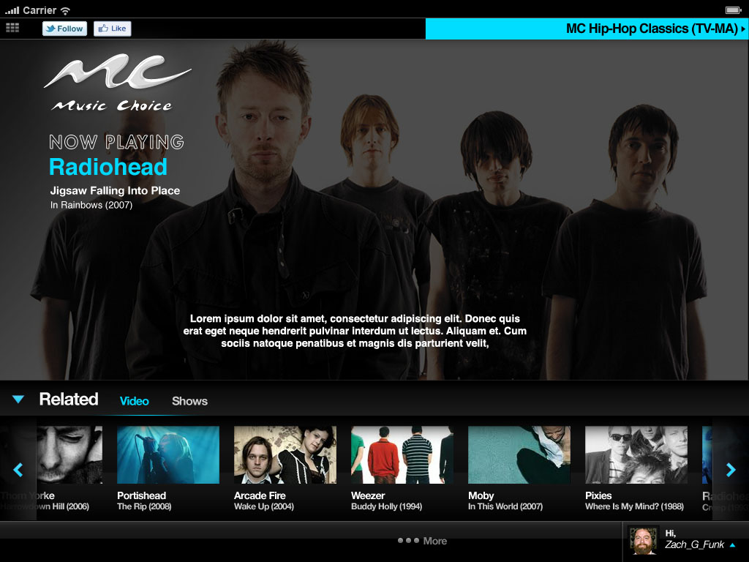
Video - Related Bar
The Related bar has 3 conditions when it appears on a channel:
Video only– for channels without block programming
Video and Shows – for channels with block programming
No Bar – on channels or songs/videos with no related video
The Related Bar changes with each song or channel change
Videos – Videos that appear in the related bar are related to the artist that is currently playing (both audio channel and single play video) Content can be videos, originals, mini-content. Mini-content should be treated as Originals
Note: Requirements for the order in which the videos appear are posted separately in Clearspace
Shows – requirements for what appears when Shows are chosen are covered in previously releases for U&A and MCU; therefore it will already have been implemented as a part of the MCU release
1
20

Slide 15
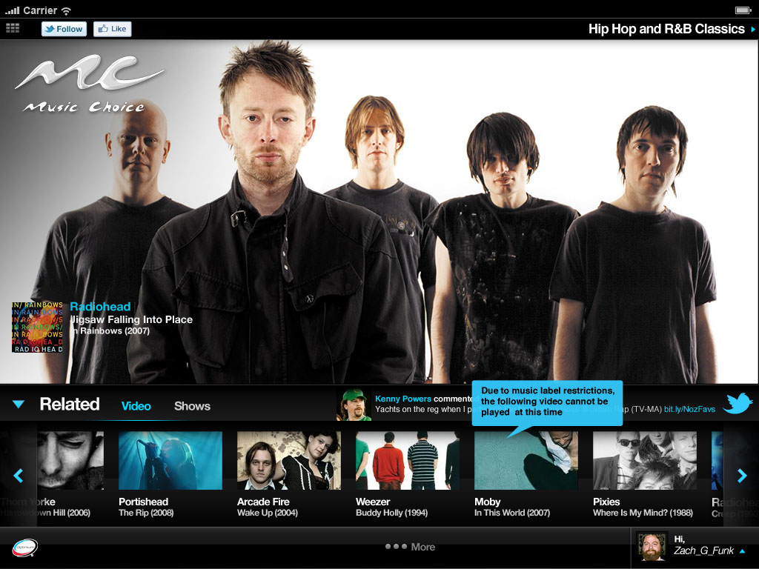
Universal Video Rights
This demonstrates what happens when someone clicks on a video that has restricted rights.
1
2

Slide 16
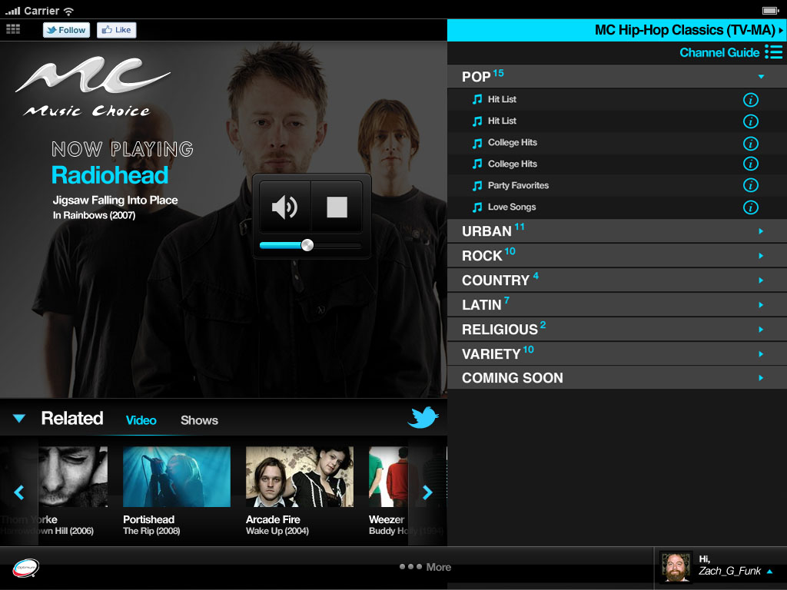
Channel Drawer
This demonstrates the Channel Drawer.
1. Channel Guide
This demonstrates how categories will be handled in the Channel Drawer. Each category shows how many channels are in it.
Channel names are listed in the 2nd tier .
The information icon links to the information section in the drawer.
This is the channel the user is currently listening to
This shows the play/volume and volume controls in the active state.
The related bar with related shows and videos that change depending on what’s playing.
4
1
2
5
3
6
2

Slide 17
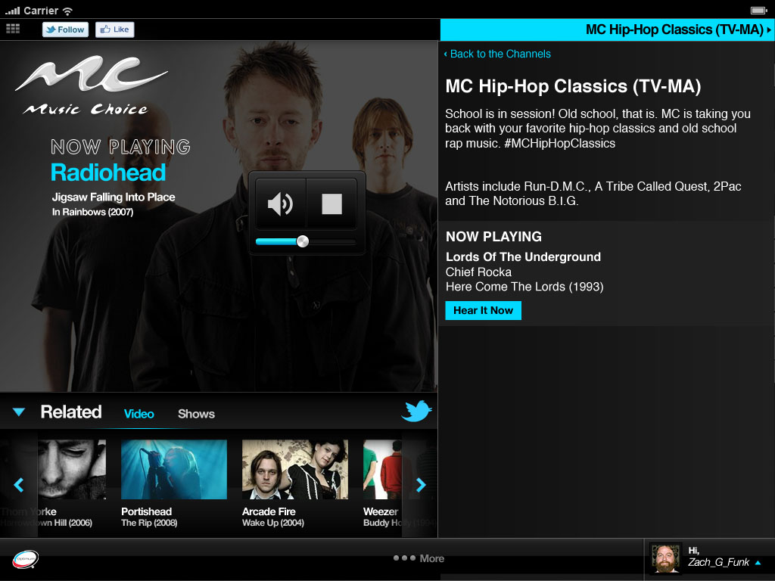
Channel Drawer Detail
This demonstrates the Channel Drawer changes needed to handle Originals.
1. Channel name
Channel info
Artists typically on that channel
This is the channel the user is currently listening to.
Back to channel list takes you to the list view of the channels.
Now Playing has the artist currently playing on that channel. Hear it now will take you to the channel.
4
1
2
3
6
2

Slide 18
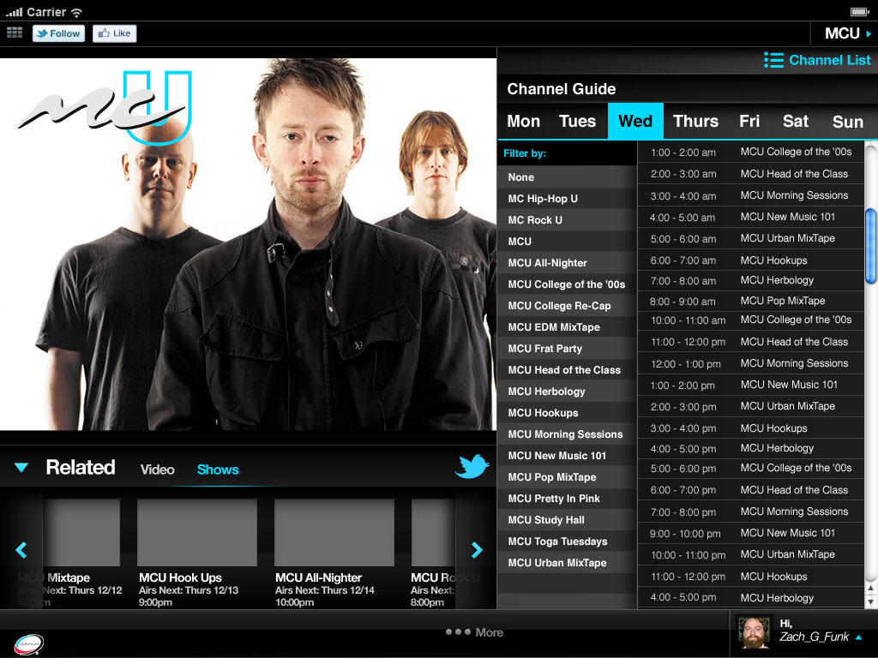
Channel Guide
This demonstrates the Channel Guide.
1. This is the day of the week filter for showing results based on each day.
This demonstrates how to filter by show titles.
Shows the results of the filters.
Clicking the Channel list will return you to the channel list view.
4
1
3
2
2

Slide 19
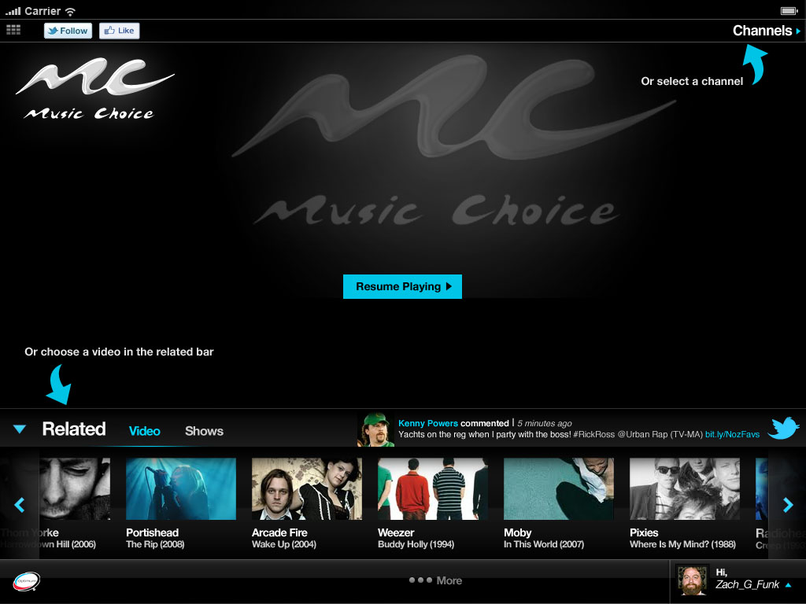
Audio Channels – “Are You Still Listening?” Prompt
This is the screen view when the user says No. Messaging is provided informing the user of 3 ways to resume the media experience:
They have the option to Resume Playing the last channel they were listening to
They can choose a video from the related bar
They can select a new channel
3
1
2
2

Slide 20
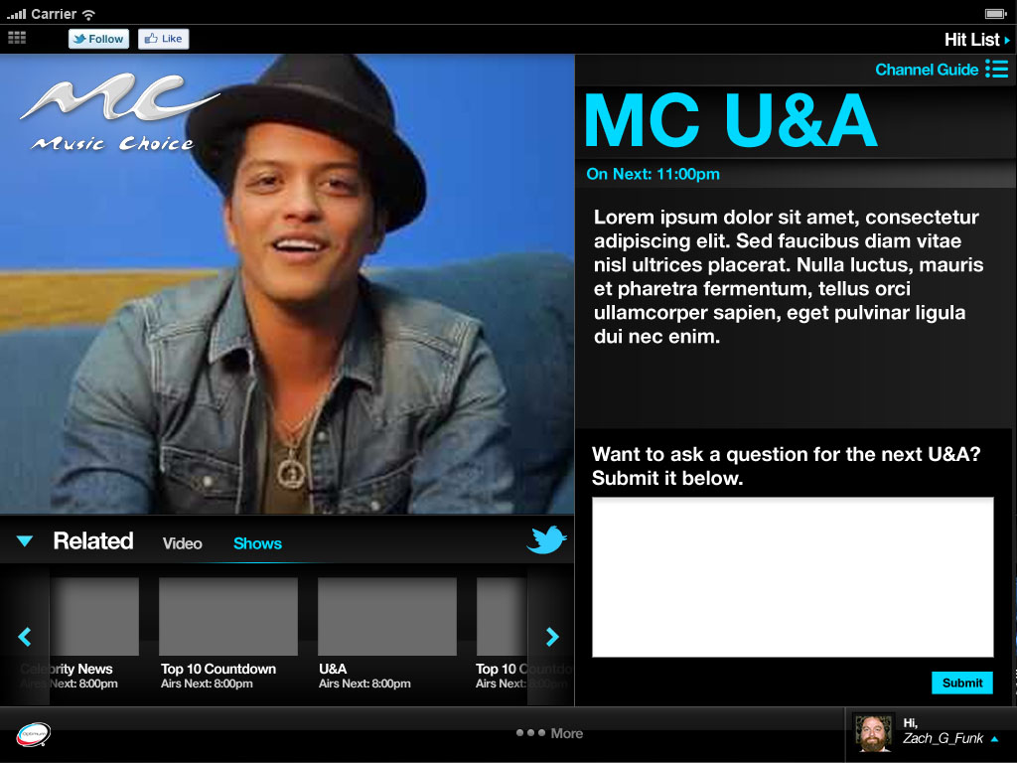
MC U&A
This demonstrates MC U&A when the show is not live.
1. If the show is not live, people can submit questions for future shows.
Shows the next time the show is on.
Informational copy for the shows.
This takes you to the channel guide that shows when the future episodes of MC U&A are airing.
4
2
3
1
2

Slide 21
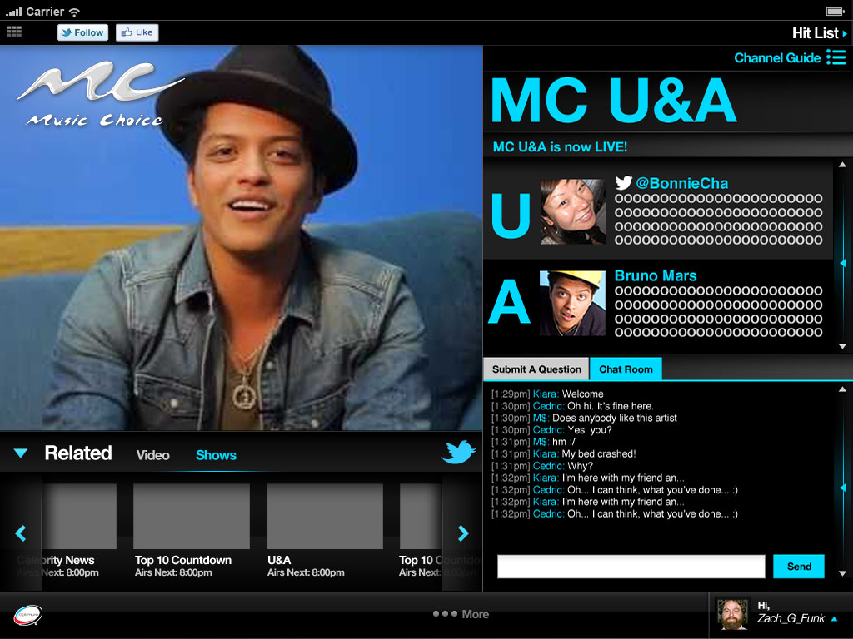
MC U&A
This demonstrates MC U&A when the show is live.
1. The chat room where listeners can chat with each other
Shows a listeners question
Shows the artists response.
2
3
1
2

Slide 22
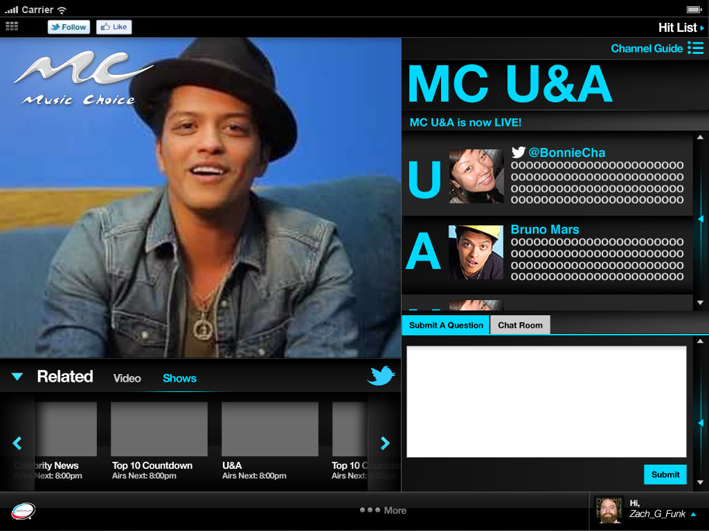
MC U&A
This demonstrates MC U&A when the show is live.
1. Here, listeners can enter questions for the artist.
This is where the listeners question will appear if selected.
Shows the artists response.
2
3
1
2

Slide 23
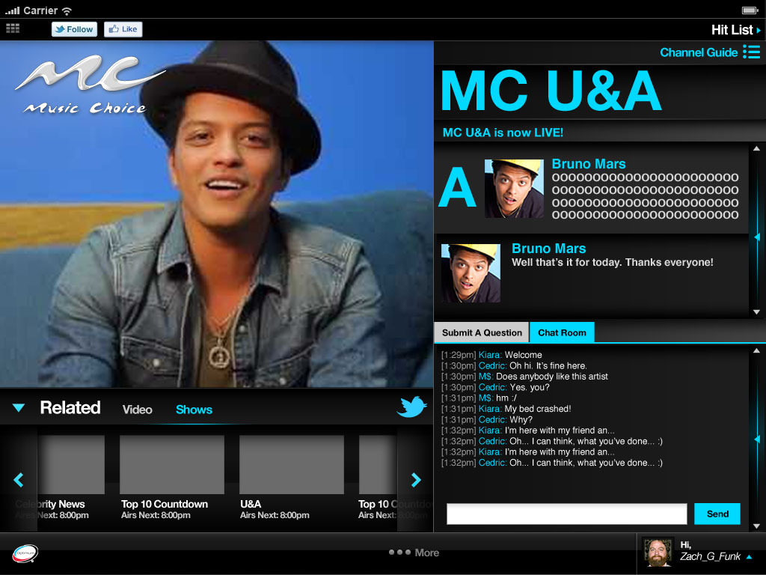
MC U&A
This demonstrates MC U&A when the show is live.
This shows the difference between an artists answer and the artist making statements.
1
2

Slide 24
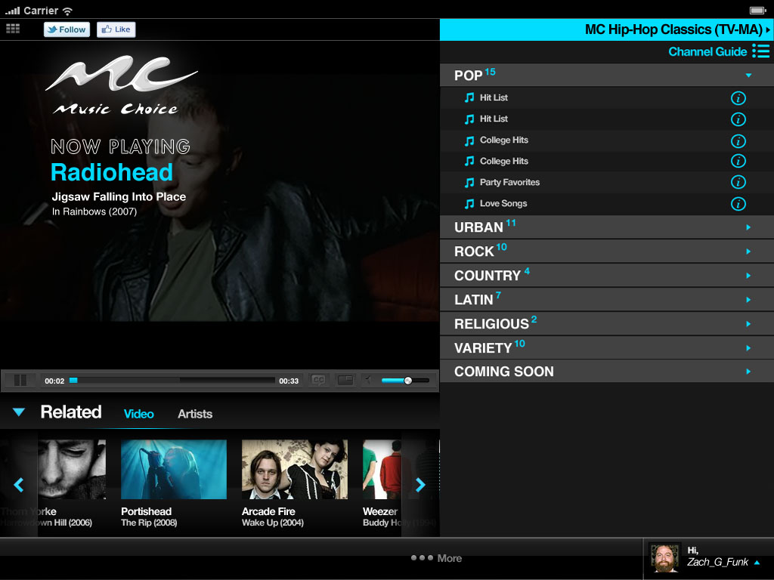
Video Play w/ Closed Captioning
1. The Closed Captioning option is located in the player control bar.
There is a legal requirement for video to be closed captioned by 9/30/12.
1
13

Slide 25
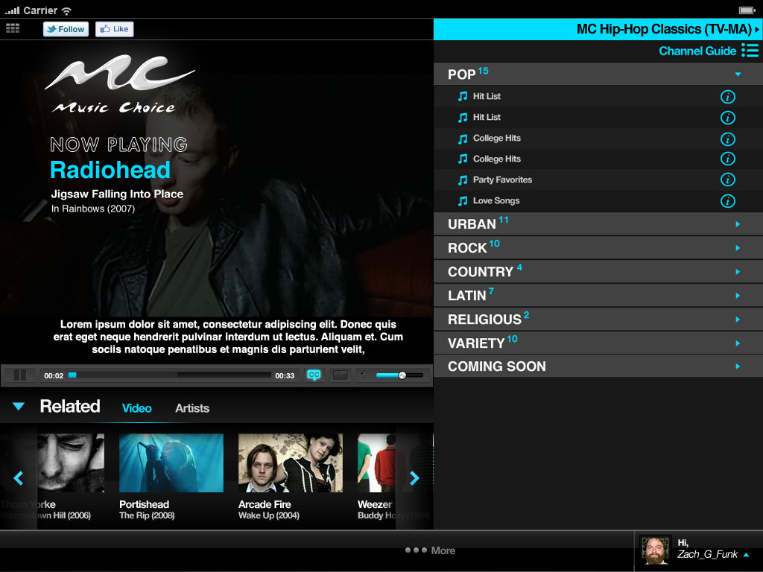
Video Play w/ Closed Captioning
1. Closed Captioning text should appear as 3 lines centered in the player window
1
14

Slide 26
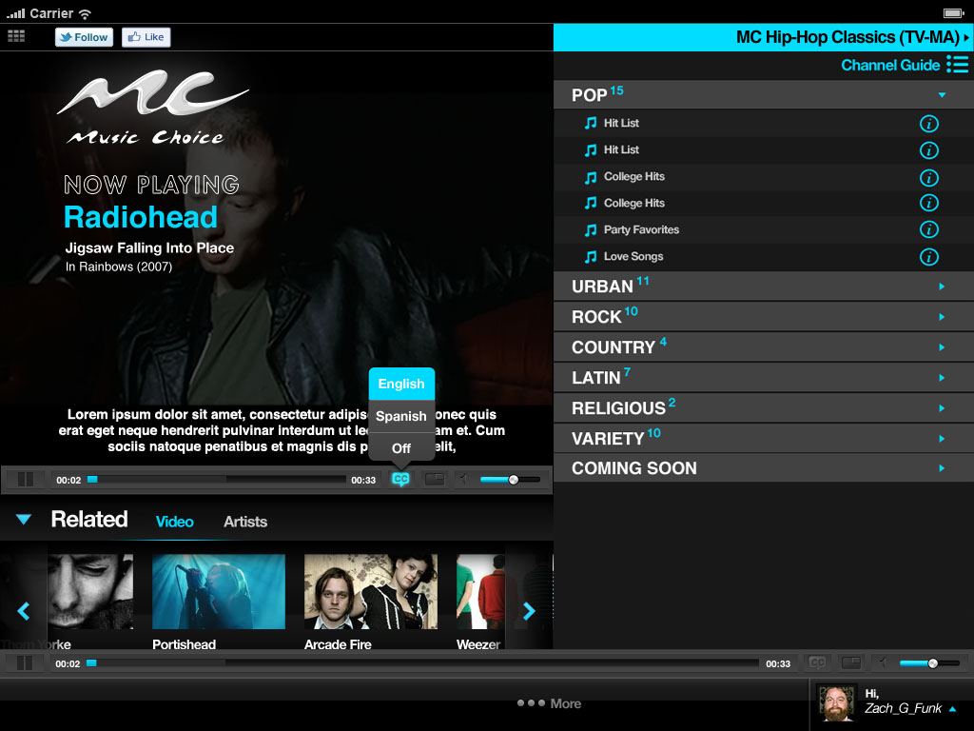
Video Play w/ Closed Captioning
1. When the user clicks on the Closed Captioning icon, they have 3 options:
English
Spanish – not in feed; need to translate to Spanish
Off
1
15

Slide 27
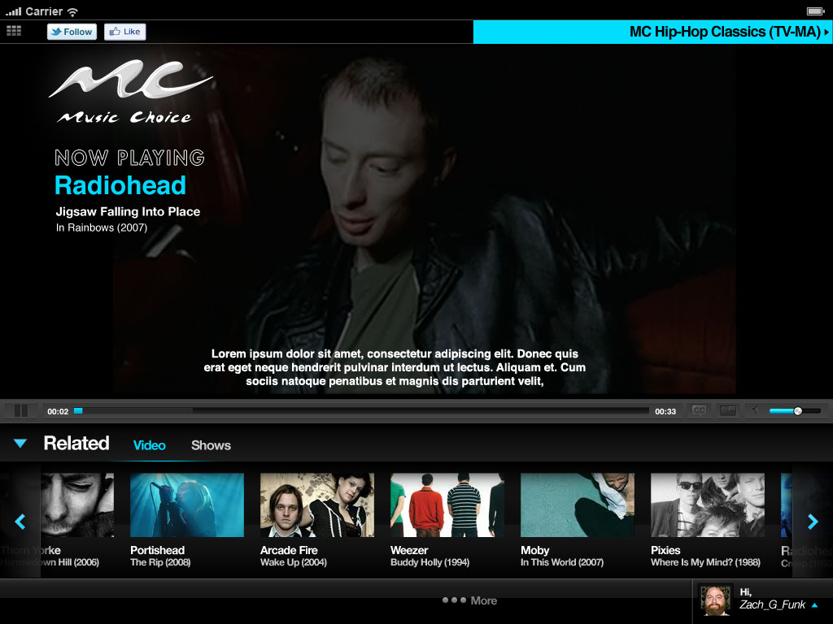
Video Play w/ Closed Captioning
1. Full View Version w/player control bar- Closed Captioning text should appear as 3 lines centered in the player window. The width of the lines is the same as when the channel drawer is open.
1
16

