Slide 1
Web/app demo discussion
Company Meeting
May 30 - June 1, 2012

Slide 2
The Music Choice Experience
The new web/app supports our 2012 rebranding effort, bringing to market an extensive feature expansion that will reinforce our LIVING MUSIC strategy
Consumers can easily glide along the spectrum of engagement depending on their desire/mood at that moment
Different products are integrated as features rather than presented as a series of products where you decide what you want to use right now (and exclude what you don’t want to use)
Web, tablet and phone with full integration into social networks
iPad, iPhone, Android Phone
PASSIVE
ENGAGING
IMMERSIVE

Slide 3
The Music Choice Experience
TV Everywhere
Industry term referring to the ability of a cable customer to watch their cable TV service on devices other than the TV
Websites
Tablets
Phones
Game Consoles (Xbox)
MC supports the cable industry’s TV Everywhere efforts
maintains our dual revenue business model
Users must be a cable customer to gain access to our audio/video/SWRV content on our website/apps
we authenticate on our website today
HBO Go is a good example of the user experience
our affiliate contracts determine the type of cable service a customer must have in order to get full access to our site/apps

Slide 4
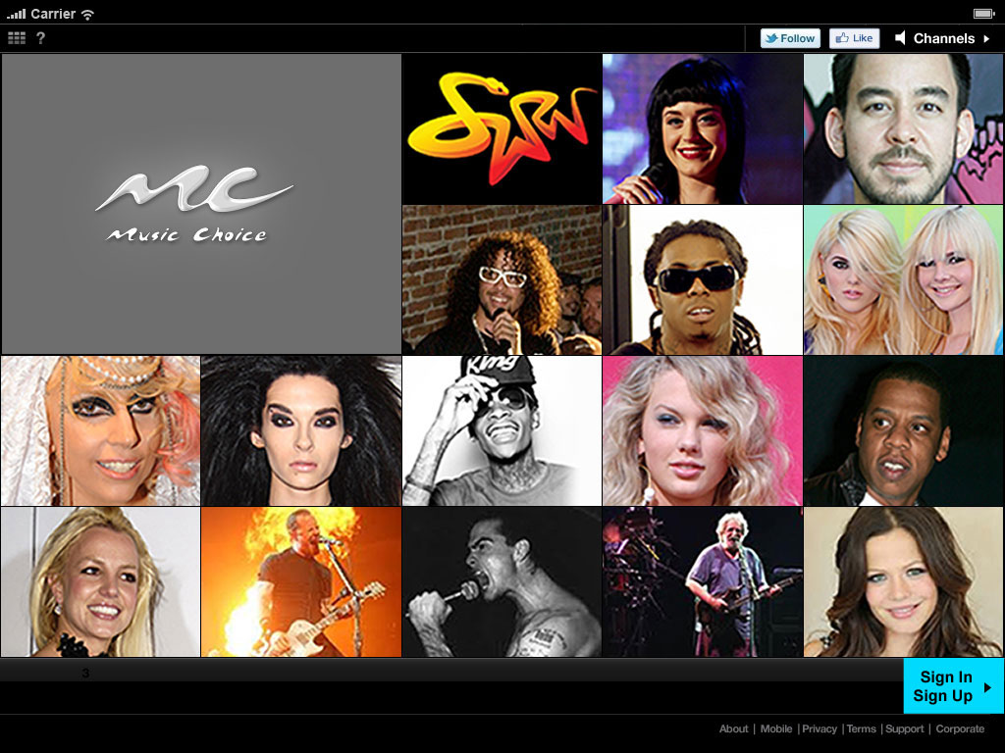
Web/App Overview
Landing Page – First Time User
Need landing page image

Slide 5
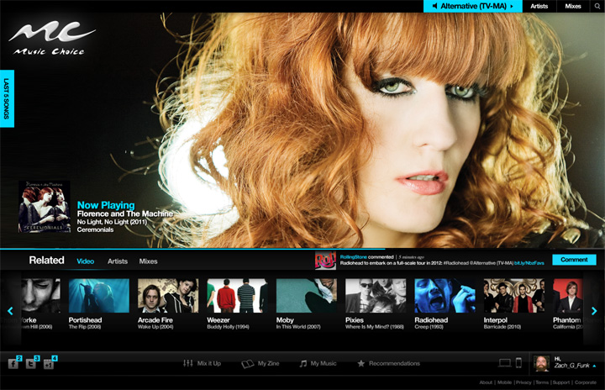
Web/App Overview
Media Player (Audio/Video) - PASSIVE

Slide 6
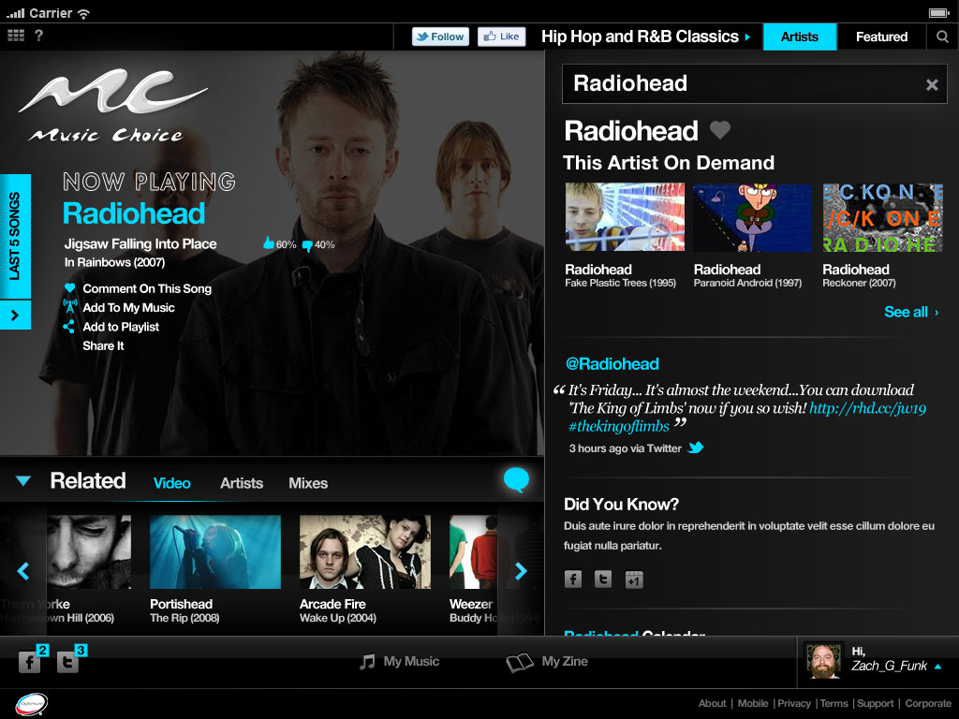
Web/App Overview
Media Player (Audio/Video) - ENGAGED
Need an image of player with Now Playing and Artist drawer open

Slide 7
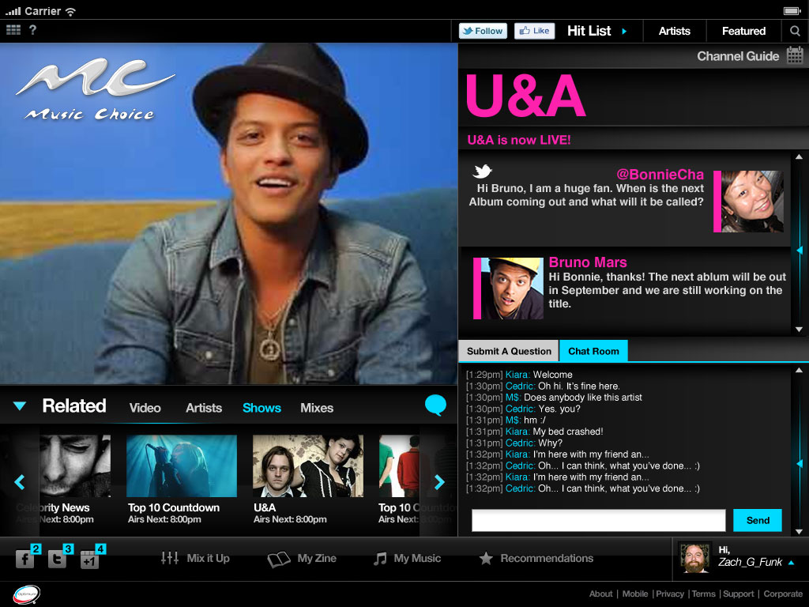
Web/App Overview
Block Programming
U&A image

Slide 8
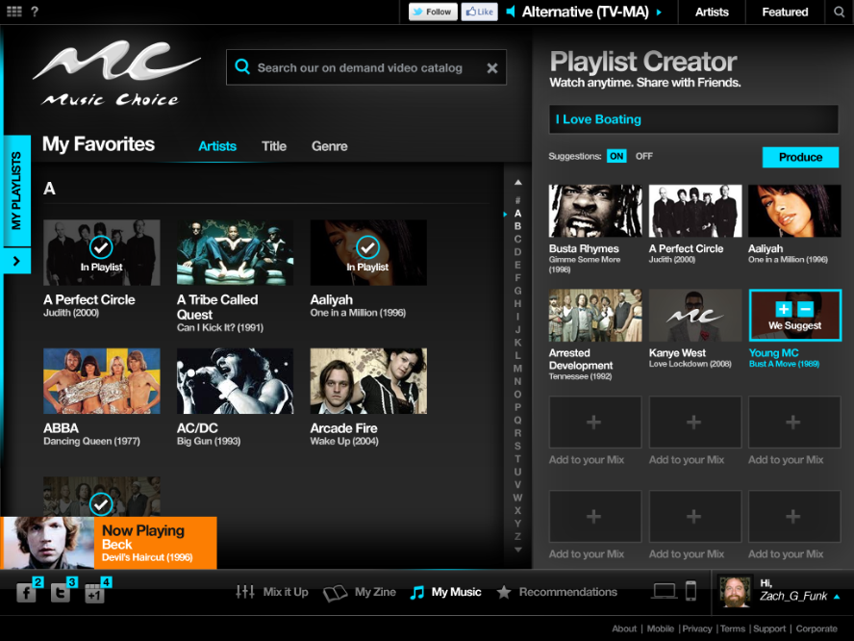
Web/App Overview
My Music

Slide 9
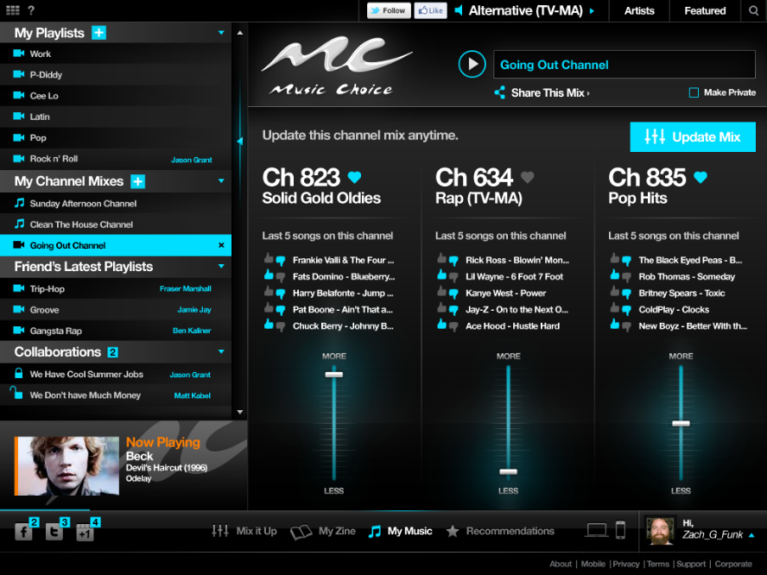
Web/App Overview
Mix It Up – By Channel

Slide 10
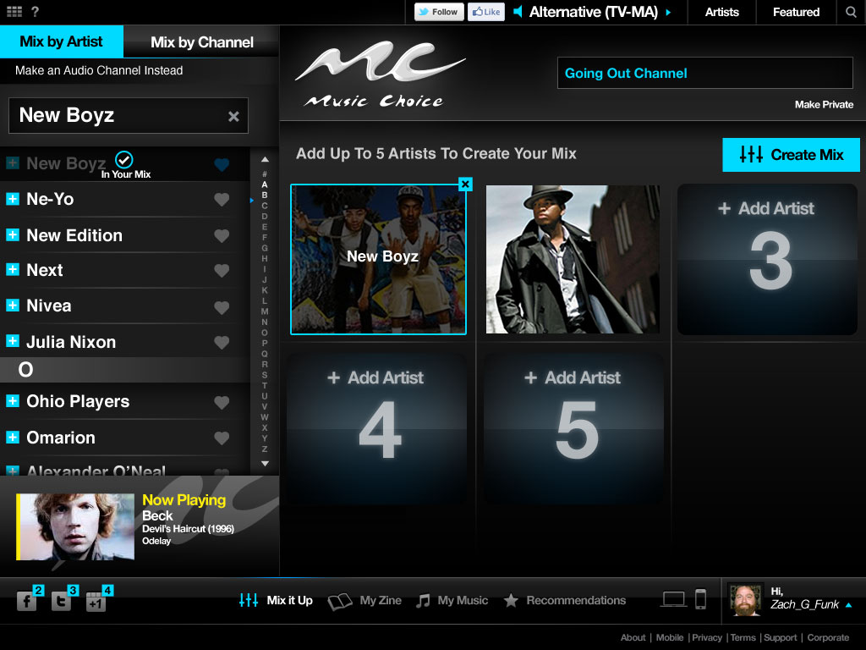
Web/App Overview
Mix It Up – By Artist

Slide 11
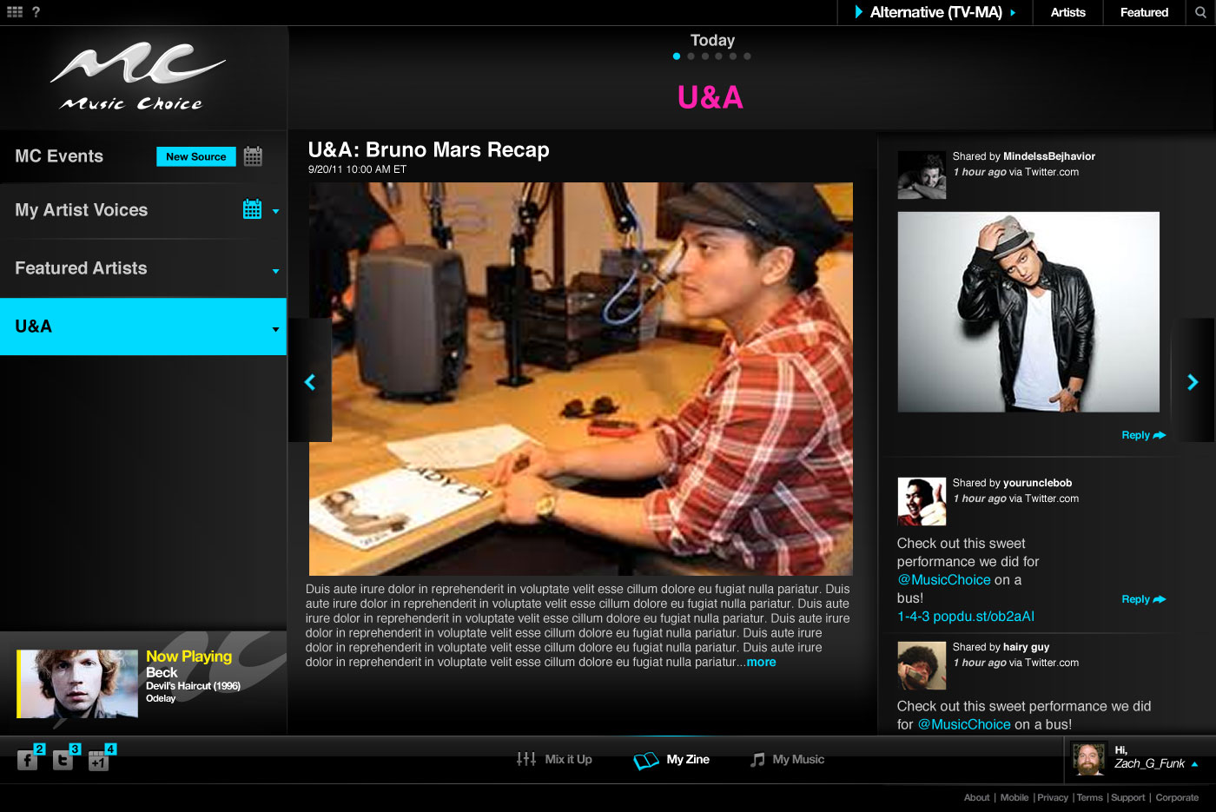
Web/App Overview
My Zine

Slide 12
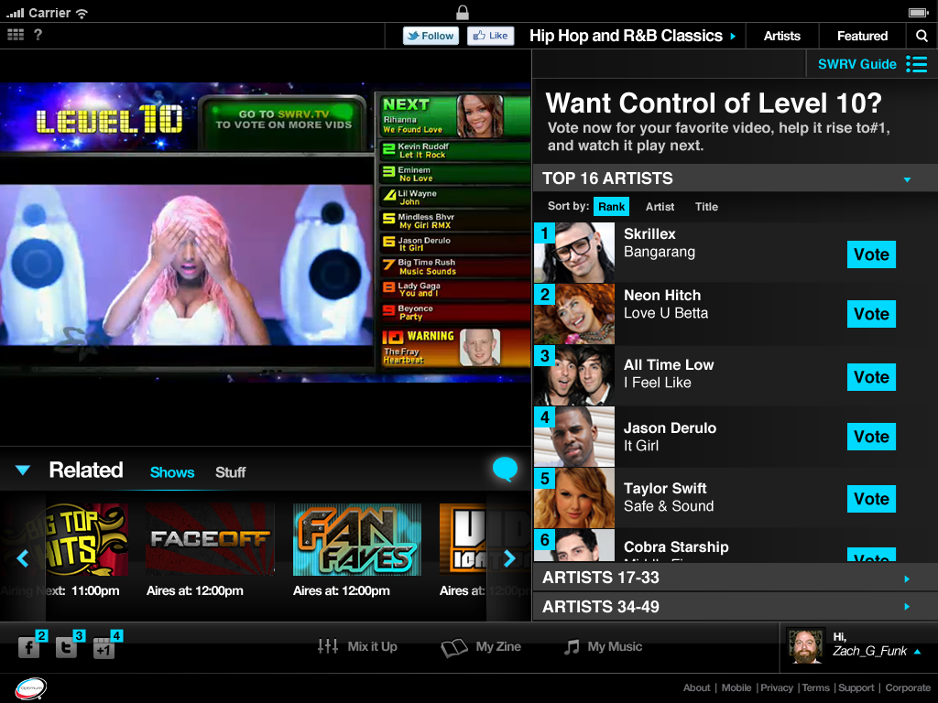
Web/App Overview
SWRV

Slide 13
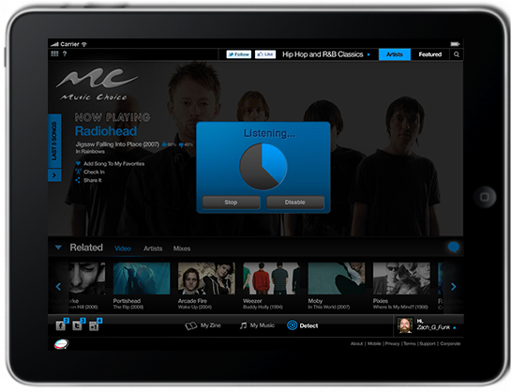
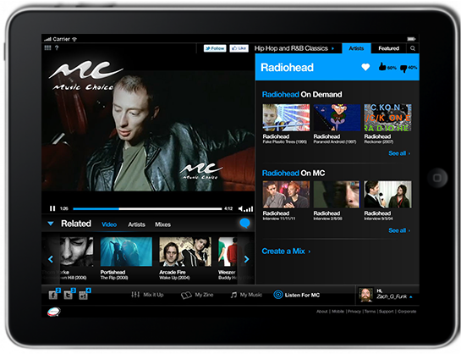
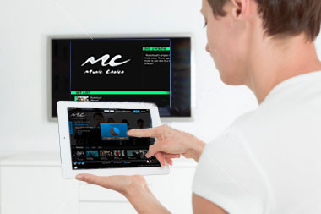
Web/App Overview
Watermarking Concept
App used as a second screen video compliment to TV audio experience
Radiohead playing on Hit List channel on TV
Watermark identified through audio and decoded by MC app
Consumer opens MC app while listening to Hit List Channel
Radiohead videos presented to the consumer on app
Consumer chooses to watch video on the app (longer term also has option to watch on TV)

Slide 14
Feature Release Plan
R1 - 6/28 | R2 – Aug | R3 – Oct | R4 - Dec
46 audio ShowOff U&A Artist Tweets VOD (handful of videos for key channels) SWRV.tv will remain in place | Video ads/promos (pre-roll &tune-in) Wallpaper ads/promos 10,000 videos w/Search Watermarking MCU Last 5 played Share | Video ads/promos (post-roll) Favorite audio channels

