Slide 1
Value Proposition
JANUARY 2020

Slide 2
Contents
What is a Value Proposition
Top Characteristics of a Great Value Proposition
Most Common Value Proposition Mistakes
Where Should You Put Your Value Proposition
4 Steps to Create a Value Proposition
What Customers Think of Us
12 Value Propositions Shoppers Care About
Examples
3
4
5
6
7
11
12
13

Slide 3
What is a Value Proposition
A simple statement describing which problems your store solves, positioning yourself against the competition and highlighting key features. You know why your company is great, but do your potential customers know what sets your business apart?

Slide 4
Top Characteristics of a Great Value Proposition
Be concise and easy to understand
Define what you do
Explain how your business resolves a pain point for your potential customer
Be displayed prominently on your website and/or your consumer touch points
It should include what customers already expect from businesses in your space
Your value proposition should encompass as least one clear unique selling proposition (USP)
Your mix of value should be unique
It should be obvious
Peter Sandeen says the idea is to “hit people over the head with what makes you different.”

Slide 5
Most Common Value Proposition Mistakes
Not having proof
Not being clear
Not testing
It’s not a mission statement
It’s not a slogan
It’s not a unique selling proposition – a specific unique feature of your store
Mission Statements and slogans derive from your value proposition. They’re not the value proposition itself

Slide 6
Where Should You Put Your Value Proposition
In the header
On the homepage
On your product and checkout pages

Slide 7
4 Steps to Create a Value Proposition
1. Define your markets problems and delights
Along with alleviating pain, a good value proposition provides customers with greater and more “delightful” benefits.
Understanding the customer needs, wants, and fears will feed into your store.

Slide 8
4 Steps to Create a Value Proposition
2. Hone in on underserved markets
Including elements in your value proposition that cater specifically to underserved markets, special discounts to students, for example.

Slide 9
4 Steps to Create a Value Proposition
3. Include unique selling propositions
What features do you provide that are unique to your store?

Slide 10
4 Steps to Create a Value Proposition
4. Create a statement of your value proposition
A statement made up a few sentences that summarizes your overall VP. This is where you communicate the key value-points of your VP.
Bullet-points that outline USPs, supporting features, and smaller benefits.
Small “booster” features that you provide that will appeal to specific segments of your market and customers with unique problems (such as shipping to remote places).

Slide 11
What Customers Think of Us
Based solely on their impressions of the homepage, participants were asked to characterize the brand in 3 words*
Communication Creative Customer-focused Engaging Equipment Exciting Focused Fun Innovative
Inviting Modern Motivating Technology Wow Accessible Creative Familiar Friendly
High-tech Professional Quality Reliable Specialized Technology Trustworthy Unknown Value
*Based on the Major Site Review 2019

Slide 12
12 Value Propositions Shoppers Care About
Based solely on their impressions of the homepage, participants were asked to characterize the brand in 3 words*
1. Your Products Are Easy to Find Online
2. Free, Fast Shipping is Now an Expectation
3. The Ability to Browse, Compare and Buy from Anywhere
4. Sharing Your Customer’s Values and Passions
5. Help is Easy to Find and Communicate With
6. Detailed Online Order Tracking
7. Generous Return Policy
8. Customized Recommendations
9. Subscribe and Save
10. Transparent, Upfront Pricing
11. Automatic Delivery
12. Personality Instead of Corporate Drones

Slide 13
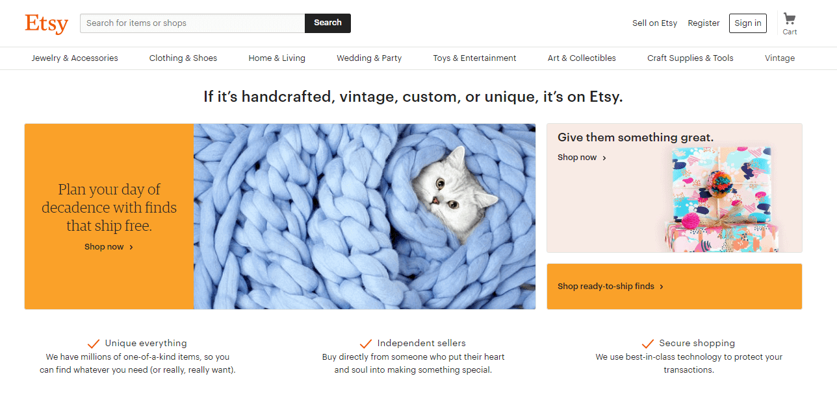
Examples
Etsy’s slogan – “If it’s handcrafted, vintage, custom, or unique, it’s on Etsy.” – summarizes its value proposition of providing special, handmade products with a personal connection to the creator.
Below they expand on their value propostion: uniqueness, independent sellers and secure shopping.

Slide 14
Examples
Warby Parker provides savings of time and money by delivering low-cost frames directly to its customers’ doors.
The opportunity to sample numerous products in a market that’s dominated by expensive, high-end retailers that don’t allow customers to try multiple products without going into a brick-and-mortar store.
Free shipping and returns.
The use of high-quality materials for a mid-level price when most competitor products are either high-quality luxury or low-quality cut-price models.

Slide 15
Examples
Amazon provides a unique mixture of choice, speed, and convenience.
Few online retailers offer the sheer scale of products (you can buy everything from the latest bestsellers to open top fire-pits) along with fast shipping and ease of purchase through one-click buying.

Slide 16
Examples
Crutchfield’s value proposition rests on the package of services – such as warranty support, lifetime customer service, returns, in-person advisors, and more – that it offers to customers.
Customers can access dedicated advisors while shopping for products, a feature offered by very few online retailers.
Products also come with a lifetime customer support package, a 60-day returns policy and a 60-day price guarantee.

Slide 17
Examples
Mizzen and Main’s core value proposition rests on the unique product it offers. All shirts sold through its ecommerce site are made with a fabric that solves several key problems associated with traditional dress shirts – it wicks sweat, is machine washable, stretches, and is breathable.
They use language that resonates with masculine audience: “The Best Damn Dress Shirt”.
Mizzen and Main also offers all the extras you would expect with a premium clothing company, such as free shipping and complimentary returns.

